Slide 1
Learning Perl
Chen Ken 2012/07/22

Slide 2
Agenda
What is perl
Perl data type
Scalar data
List and Array
HashTable
Control structure
Subroutine
I/O, FILE and Dir
String
Regular Expression
Perl Module
Process management
Advanced Perl techniques

Slide 3
Perl
Perl
Practical Extraction and Report Language
CPAN
Comprehensive Perl Archive Network
http://www.cpan.org

Slide 4
Scalar
Scalar (only store one single value)
Numbers, “Internally, Perl computes all numbers with double-precision floating-point values, which means that there is no integer values internal to Perl”
Floating-Point, 1.25, -12e-24
Integer, 2012, -40
Nondecimal Integer, 0377, 0xFF, 0b11111111 (hex, oct conversion func)
String with single quoted quotes, like raw string in Python
String with double quoted quotes, supports variable interpolated
Reference
undef

Slide 5
Scalar
String operator
"hello" . "world“ (. for concat string)
“fred” x 3 => “fredfredfred” (x to string repetition)
5 x 4 => “5555”
Automatic Conversion Between Numbers and Strings
For the most part, Perl automatically converts between numbers and strings as needed. It all depends upon the operator being used on the scalar value
“12” * “3” => 36
“12fred34” * 3 => 36
“fred” * 3 => 0 * 3 = 0
“Z” . 5 * 7 => “Z”.35 => “Z35”

Slide 6
Scalar
Scalar variable (use $ to define/use scalar var)
my $i = 0;
my $str = “string”;
Variable interpolation
print “$str”
print “${str}” # in order to avoid confusion

Slide 7
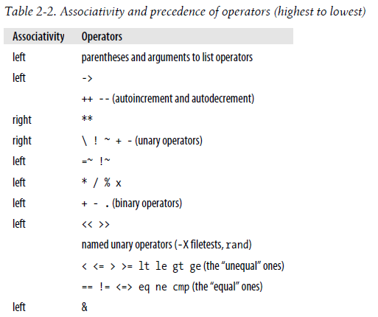
Operator Precedence and Associativity

Slide 8
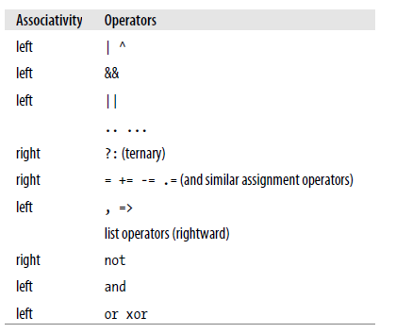
Operator Precedence and Associativity
perldoc perlop for more detail

Slide 9
Scalar
Scalar variable (use $ to define/use scalar var)
my $i = 0;
my $str = “string”;
my $withOutInit # Set to undef
Variable interpolation
print “$str”
print “${str}” # in order to avoid confusion

Slide 10
STDIN
Read lines from stdin
my $line = <STDIN>;
chomp $line # Get rid of (only) the last newline character
“$/” is the input seperator which controls when <STDIN> returns
When EOF is seen, <STDIN> returns undef $anotherLine = <STDIN> if ($defined($anotherLine) { }

Slide 11
Lists and Arrays
List and Array
A list is an ordered collection of scalars. An array is a variable that contains a list.
List is the data, and the array is the variable
Each element of an array or list is a separate scalar variable with an independent scalar value
Use @ to define an array variable
my @arrWithoutInit # Set to empty array
printf “The items are :\n”.(“%10s\n” x @items), @items;
Array index begins with 0
my @arr = (1, 2, 3, 4);
$arr[$#arr] => 4
$arr[-1] => 4

Slide 12
Lists and Arrays
List literal
(1, 2, 3)
(1..100) # list of 100 integers
(1.7..5.7) # same as (1..5)
(5..1) # empty list
(0, 2..6, 1, 12)
(0..$#arr)
qw shortcut
qw! fred barney betty wilma dino !
qw{ fred barney betty wilma dino } etc

Slide 13
Lists and Arrays
List/Array manupilation
($a, $b, $c) = (1, 2, 3);
($fred, $barney) = ($barney, $fred); # Exchange the two vars
@tiny = ();
@giant = 1..1e5;
@stuff = (@giant, undef, @giant);
$fred = pop(@stuff);
pop @tiny; => undef
push (@tiny, “not tiny any more”);
push @tiny, 1..9;
$firstElement = shift @tiny;
shift @tiny; # @tiny becomes empty
unshift @tiny, “again, not tiny any more”;
unshift @tiny, 1...9;

Slide 14
Lists and Arrays
Interpolating Arrays into Strings
@rocks = qw{ flintstone slate rubble }; print "quartz @rocks limestone\n"; # prints five rocks separated by spaces
$” special variable control how to separate the elements in the array while interpolated into string
$y = “2 * 4”; $x = “this is $rocks[$y – 1]’s test”; # this is flintstone’s test Note that the index expression is evaluated as an ordinary expression, as if it were outside of the string
@fred = qw(eating rocks is wrong); $fred = “right”; print “this is $fred[3]”; # wrong print “this is ${fred}[3]”; # right print “this is $fred”. “[3]”; # right print “this is $fred\[3]”; # right

Slide 15
Lists and Arrays
reverse operator
@fred = 1..6; @barney = reverse @fred; # 6, 5, …, 1
Note: reverse doesn’t change the array in place, it returns a new array
sort operator
Order by internal character ordering of its element
As reverse, doesn’t change the array in place, it returns new array
@fred = sort (@barney);

Slide 16
Scalar and List Context
Context
A given expression may mean different things depending upon what the context is. The context refers to where an expression is found. As Perl is parsing your expressions, it always expects either a scalar value or a list value. What Perl expects is called the context of the expression
@people = qw( fred barney betty ); @sorted = sort @people; # list context: barney, betty, fred $number = 42 + @people; # scalar context: 42 + 3 gives 45 $n = @people; # the number 3 $backwards = reverse qw/ yabba dabba doo /; # gives oodabbadabbay $fred = something; # scalar context @pebbles = something; # list context ($wilma, $betty) = something; # list context ($dino) = something; # still list context!

Slide 17
Scalar and List Context
Force scalar context
scalar fake function @rocks = qw( talc quartz jade obsidian ); print "I have ", scalar @rocks, " rocks!\n"; # Correct, gives a number
STDIN in list context
my @lines = <STDIN>; # read all lines until EOF, ctl + d (z) chomp(@lines); # Get rid of all last newline char for all lines

Slide 18
HashTable
Definition
Use % to define a hash table variable, prefer to use big arrow (=>) to represents key => value relationship my %hashTbl = { “fred” => “flintstone”, “dino” => “rubble”, }; my %hashTbl2 = (“key1”, “value1”, “key2”, “value2”);

Slide 19
HashTable
Manipulation
@anyArray = %hashTbl; # unwinding the hash
%inverseHash = reverse %hashTbl; # (key, value switched)
my @k = keys %hashTbl;
my @v = values %hashTbl;
$hashTbl{“Hello”} = “world”; # insert or override
delete $hashTble{“Hello”}; # the key value pair will be erased
while ((my $k, my $v) = each %hashTble) { }
if (exists $hashTble{“dino”}) {} # Test if the key is in the hash table
%ENV – built in hash table in running time

Slide 20
Boolean
Boolean
If the value is a number, 0 means false; all other numbers mean true
Otherwise, if the value is a string, the empty string ('') means false; all other strings mean true
Otherwise (that is, if the value is another kind of scalar than a number or a string),convert it to a number or a string and try again
‘0’ and 0 are the same thing in Perl, they are both false
undef, first convert it to string ‘’

Slide 21
Control Structure
if/else (Note, the brace can’t be omitted) if ($thisIsTrue) { } elsif ($thatIsTrue) { }
else { }
while (true) { }
foreach my $elem (@arr) { # $elem is not a copy from the @arr, # it is a reference pointing to the element in @arr, so changes to $elem # will change the element in @arr eventually }

Slide 22
Control Structure
unless (thisIsFalse) { execute the code here… } else { }
until (thisIsFalse) { execute the code here… }
for (init; test; increment) { }
last operator, like break in C
next operator, like continue in C

Slide 23
Control Structure
redo operator
It goes back to the top of the current loop block, without testing any conditional expression or advancing to the next iteration
Labeled Blocks (use the label after last, next, or redo)
LINE: while (<>) { foreach (split) { last LINE if /__END__/; # bail out of the LINE loop … }
?:
The defined-or Operator // foreach my $try ( 0, undef, '0', 1, 25 ) { print "Trying [$try] ---> "; my $value = $try // 'default'; say "\tgot [$value]"; }

Slide 24
Subroutine
Define a subroutine
sub foo { print “hey, foo\n”; }
&sub # call subroutine
Always call subroutine by using &, best practice
Keynotes
If we define two subroutines with the same name, the later one will override the previous one
No explicit arguments specification
No static private subroutine unless you use advanced techniques (coderef)
The value of the last expression in the routine will be the return value if no explicit return is stated
The arguments is saved in special @_ array, $_[0], $_[1], …
state keyword act as static keyword in C

Slide 25
I/O
Diamond operator read from file/stdin
<>
IO manipulation
my success = open my $fileHandler, ‘>>’, “file.txt” or die “$!”;
print $fileHandler “another line\n”; # no comma after the handler
close $fileHandler;
select STDERR; # from now on, all output will be written to STDERR
$! Special var controls the buffering (0 : buffer, 1 : non-buffer)

Slide 26
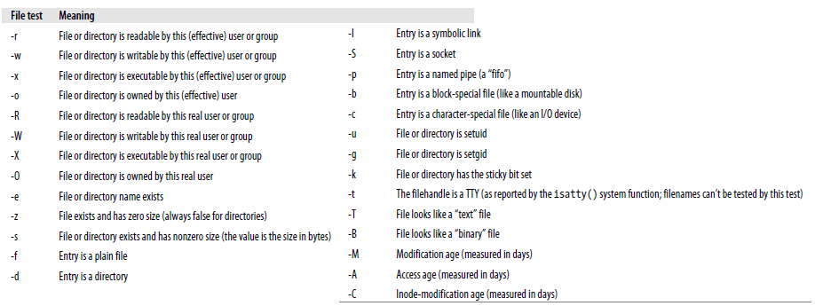
File/Dir
File test operators

Slide 27
File/Dir
Example
foreach (@lots_of_filename) { print “$_ is readable\n” if -r; }
if (-r $file and -w $file) { } # The one is more efficient, stat is called only once, _ acts like cache if(-r $file and -w _) { }
Stacking the test if (-w -r -x -o -d $file) { }

Slide 28
File/Dir
stat/lstat
my($dev, $ino, $mode, $nlink, $uid, $gid, $rdev, $size, $atime, $mtime, $ctime, $blksize, $blocks) = stat($filename);
If stat fails, it returns empty list
Invoking stat on the name of a symbolic link returns information on what the symbolic link points at, not information about the symbolic link itself (unless the link just happens to be pointing at nothing currently accessible)
If you need the (mostly useless) information about the symbolic link itself, use lstat rather than stat (which returns the same information in the same order). If the operand isn’t a symbolic link, lstat returns the same things that stat would

Slide 29
File/Dir
localtime
my $timestamp = 1180630098; my $date = localtime $timestamp;
In list context: my($sec, $min, $hour, $day, $mon, $year, $wday, $yday, $isdst) = localtime $timestamp;
gmtime
time
Bit operator
10 & 12, 10 | 12, 10 ^ 12, 6 << 2, 25 >> 2, ~10
warn "Hey, the configuration file is world-writable!\n” if $mode & 0002;

Slide 30
File/Dir
glob
my @all_files = glob "*"; # match all files, except prefixed with dot
my @pm_files = glob "*.pm";
Multiple patterns separated by spaces my @all_files_including_dot = glob ".* *"; # a space in between
my @all_files = <*>;
my $dir = “/etc”; my dir_files = <$dir/* $dir/.*>;
Dir handler
my $dir = "/etc"; opendir my $dirHandler, $dir_to_process or die “Failed: $!"; foreach $file (readdir $dirHandler) { print "one file in $dir_to_process is $file\n"; next unless $name =~ /\.pm$/; next if $name =~ /^\./; next if $name eq "." or $name eq ".."; }

Slide 31
File/Dir
File::Find module
Delete/move file/dir
unlink “slate”, “bedrock”;
my $successDeletedFileCnt = unlink glob “*.o”;
rename “old”, “new”;
rename "over_there/some/place/some_file", "some_file"; # move file
foreach my $file (glob "*.old") { (my $newfile = $file) =~ s/\.old$/.new/; if (-e $newfile) { warn "can't rename $file to $newfile: $newfile exists\n"; } elsif (rename $file, $newfile) { # success, do nothing } else { warn "rename $file to $newfile failed: $!\n"; }

Slide 32
File/Dir
Link file/dir
link "chicken", "egg” or warn "can't link chicken to egg: $!”;
symlink "dodgson", "carroll” or warn "can't link dodgson to carroll: $!";
my $where = readlink "carroll"; # Gives "dodgson“
my $perl = readlink "/usr/local/bin/perl"; # Maybe tells where perl is
Make dir
mkdir "fred", 0755 or warn "Cannot make fred directory: $!";
foreach my $dir (qw(fred barney betty)) { rmdir $dir or warn "cannot rmdir $dir: $!\n"; }
File::Path rmtree
Modify perm/ownership
chmod 0755, "fred", "barney";
chown $user, $group, glob "*.o";
utime $now, $ago, glob "*"; # set access to now, mod to a day ago

Slide 33
String
String manipulation funcs
my $where = index($big, $small); # return -1 if not found
my $where = index($big, $small, $start_pos);
rindex
my $part = substr($string, $initial_pos)
my $part = substr($string, $initial_pos, $length)
substr($string, 0, 5) = “Goodby”;
substr($string, -20) = ~ s/fred/barney/g;
my $prev_substr = substr($string, 0, 5, “Goodbye”);
sub format_money { my $number = sprintf “%0.2f”, shift @_; 1 while $number =~ s/^(-?\d+)(\d\d\d)/$1,$2/; $number =~ s/^(-?)/$1\$/; $number; } 12345678.9 => 12,345,678.90

Slide 34
String
Advanced sort
sub by_number { if ($a < $b) { -1 } elsif ($a > $b) { 1 } else { 0 } } sub by_number { $a <=> $b } # <=> only for numeric type my @result = sort by_number @some_numbers;
my @numbers = sort { $a <=> $b } @some_numbers;
my @descending = reverse sort { $a <=> $b } @some_numbers;
my @descending = sort { $b <=> $a } @some_numbers;
sub ASCIIbetically { $a cmp $b } my @strs = sort ASCIIbetically @any_strings; sub case_insenstive { “\L$a” cmp “\L$b” }
sub by_score { $score{$b} <=> $score{$a} } # sort hash by value my @winners = sort by_score keys %score;
sub by_score_and_name { $score{$b} <=> $score{$a} or $a cmp $b } # sort by multiple keys

Slide 35
Regular expression
Grouping in Patterns
$_ = "yabba dabba doo"; if (/y(.)(.)\2\1/) { # matches 'abba‘, back references to the text matched print "It matched the same after y and d!\n"; }
$_ = "aa11bb"; if (/(.)\111/) { # \1, or \11, or \111 ? Perl is greedy, \111 is here print "It matched!\n"; } if (/(.)\g{-1}11/) { # Use g{N} to eliminate the ambiguity }
Alternatives
/fred( |\t)+barney/ # matches if fred and barney are separated by spaces, tabs, or a mixture of the two
/fred( +|\t+)barney/ # the separators must be all spaces or all tabs

Slide 36
Regular expression
Character Classes
[abcwxyz] # match any of them, same as [a-cw-z]
[^def] # match any single character except one of those three
[^n\-z] # matches any character except for n, hyphen, or z
Character Class Shortcuts
[0-9] => \d
[A-Za-z0-9_] => \w
[\f\t\n\r ] => \s
[\t ] => \h
[\f\n\r] => \v
[^\d] => \D
[^\w] => \W
[^\s] => \S

Slide 37
Regular expression
Matches with m//, shortcut is //
We can use any delimeter: m(fred), m<fred>, m{fred}, or m[fred]
/http:\/\// => m%http://% # better
Option Modifiers
Case-Insensitive Matching with /i if (/yes/i) { }
Matching Any Character with /s $_ = "I saw Barney\ndown at the bowling alley\nwith Fred tonight\n"; if (/Barney.*Fred/s) { }
Adding Whitespace with /x /-?\d+\.?\d*/ => / -? \d+ \.? \d* /x / \d+ # one or more digits before the decimal point \.? # an optional decimal point /

Slide 38
Regular expression
Option Modifiers (more, see perlop m// section)
Combining Option Modifiers if (/barney.*fred/is) { # both /i and /s } if (m{ barney # the little guy .* # anything in between fred # the loud guy }six) { # all three of /s and /i and /x }

Slide 39
Regular expression
Anchors
^ # match from beginning of a string line
$ # match from end of a string line
/^\s*$/ # match empty line
\b # word anchor, word boundary
/\bFred\b/ # match Fred, but not Frederic
\B # non-word boundary
/\bsearch\B/ # matches searches, searching, etc but not research or search
The Binding Operator, =~
my $some_other = “I dream of betty rubble”; if ($some_other =~ /\brub/) { }
my $likes_perl = (<STDIN> =~ /\byes\b/i);

Slide 40
Regular expression
Interpolating into Patterns
my $what = “larry”; if (/^($what)/) { }
Pay attention to the meta character in the variable in pattern What if $what = fred(barney ? if (/^($what)/) => if (/^(fred(barney)/) will report error, use quotemeta or \Q to solve this problem (the variable will not be treated as regular expression any more)
The Match Variables
() in the regular expression captures what it matches automatically
\4 refers back to the memory during the pattern while it is trying to match, while $4 refers to the memory of an already completed pattern match (perlre for more info)

Slide 41
Regular expression
The Persistence of Memory
These match variables generally stay around until the next successful pattern match. That is, an unsuccessful match leaves the previous memories intact, but a successful one resets them all
Noncapturing Parentheses
(?:xxx) # non-capturing
if (/(?:bronto)?saurus (?:BBQ )?(steak|burger)/) { }
Named Captures
%+ hashtable saves the capture results, Perl 5.10 or higher
(?<LABEL>PATTERN), we can give LABEL a name use 5.010; my $names = 'Fred or Barney'; if( $names =~ m/(?<name1>\w+) (?:and|or) (?<name2>\w+)/ ) { say "I saw $+{name1} and $+{name2}"; }

Slide 42
Regular expression
The Automatic Match Variables (may be empty)
$`, holds whatever the regular expression engine had to skip over before it found the match
$&, has the entire matched section
$’, has the remainder of the string that the pattern never got to if ("Hello there, neighbor" =~ /\s(\w+),/) { $` => ‘Hello’ $& => ‘ there,’ $’ => ‘ neighbor’ }
The variable will slow the regular expression
General Quantifiers
{M, N}, repeated M to N times
{M, }, repeated M or more than M times
{M}, repeated M times

Slide 43
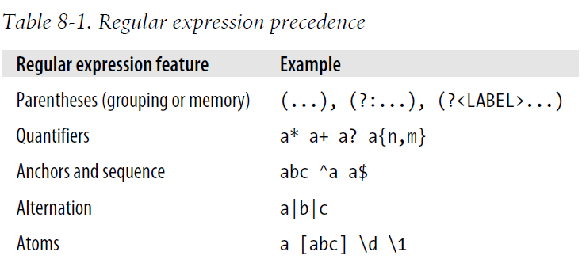
Regular expression
Precedence (perlre, perlquick, perlretut)

Slide 44
Regular expression
Substitutions with s/// (return boolean)
$_ = "green scaly dinosaur"; s/(\w+) (\w+)/$2, $1/; # Now it's "scaly, green dinosaur“ s/^/huge, /; # Now it's "huge, scaly, green dinosaur“ s/,.*een//; # Empty replacement: Now it's "huge dinosaur“ s/green/red/; # Failed match: still "huge dinosaur“ s/\w+$/($`!)$&/; # Now it's "huge (huge !)dinosaur“ s/\s+(!\W+)/$1 /; # Now it's "huge (huge!) dinosaur“ s/huge/gigantic/; # Now it's "gigantic (huge!) dinosaur“
Use /g for global substitution $_ = "home, sweet home!"; s/home/cave/g;
s/^\s+//; # Replace leading whitespace with nothing s/\s+$//; # Replace trailing whitespace with nothing s/^\s+|\s+$//g; # Strip leading, trailing whitespace

Slide 45
Regular expression
Case Shifting (\L, \U, \l, \u)
$_ = "I saw Barney with Fred."; s/(fred|barney)/\U$1/gi; # $_ is now "I saw BARNEY with FRED.“ s/(fred|barney)/\L$1/gi; # $_ is now "I saw barney with fred."
By default, these affect the rest of the (replacement) string, or you can turn off case shifting with \E: s/(\w+) with (\w+)/\U$2\E with $1/i; # $_ is now "I saw FRED with barney.“
Using \u with \L means “all lowercase, but capitalize the first letter s/(fred|barney)/\u$1/ig; # $_ is now "I saw FRED with Barney." s/(fred|barney)/\u\L$1/ig; # $_ is now "I saw Fred with Barney.“ print "Hello, \L\u$name\E, would you like to play a game?\n";

Slide 46
Regular expression
Different Delimiters
s#^https://#http://#; s{fred}{barney}; s[fred](barney); s<fred>#barney#;
Option Modifiers
s#wilma#Wilma#gi; # replace every WiLmA or WILMA with Wilma
s{__END__.*}{}s; # chop off the end marker and all following lines
The Binding Operator
$file_name =~ s#^.*/##s; # In $file_name, remove any Unix-style path

Slide 47
Regular expression
split (Text::CSV)
@fields = split /separator/, $string;
@fields = split /:/, "abc:def:g:h"; # gives ("abc", "def", "g", "h")
@fields = split /:/, "abc:def::g:h"; # gives ("abc", "def", "", "g", "h")
@fields = split /:/, ":::a:b:c:::"; # gives ("", "", "", "a", "b", "c")
split <=> split /\s+/, $_;
Use non-capture (?:) parenthese in split
join
my $result = join $glue, @pieces; The glue shows up only between the pieces, never before or after them
my $x = join ":", 4, 6, 8, 10, 12; # $x is "4:6:8:10:12“
my $y = join "foo", "bar"; # gives just "bar", since no fooglue is needed

Slide 48
Regular expression
m// in List Context
When a pattern match (m//) is used in a list context, the return value is a list of the memory variables created in the match, or an empty list if the match failed $_ = "Hello there, neighbor!"; my($first, $second, $third) = /(\S+) (\S+), (\S+)/; my $text = "Fred dropped a 5 ton granite block on Mr. Slate"; my @words = ($text =~ /([a-z]+)/ig); print "Result: @words\n"; # Result: Fred dropped a ton granite block on Mr Slate my $data = "Barney Rubble Fred Flintstone Wilma Flintstone"; my %last_name = ($data =~ /(\w+)\s+(\w+)/g); # Each time the pattern matches, it returns a pair of memories

Slide 49
Regular expression
Non-greedy
.* # greedy
.*? # non-greedy
{5, 10}?
{8,}?
?? # matches either once or not at all, but it prefers not to match anything
Matching Multiple-Line Text
$_ = "I'm much better\nthan Barney is\nat bowling,\nWilma.\n"; print "Found 'wilma' at start of line\n" if /^wilma\b/im;
The /m makes ^ and $ anchors for the start and end of each line, rather than the whole string
my $lines = join '', <FILE>; $lines =~ s/^/$filename: /gm;

Slide 50
Regular expression
Updating Many Files
Inplace modify the file $^I (set it to empty string) chomp(my $date = `date`); $^I = ".bak"; while (<>) { s/^Author:.*/Author: Randal L. Schwartz/; print; }
In-Place Editing from the Command line
$ perl -p -i.bak -w -e 's/Randall/Randal/g' fred*.dat

Slide 51
Module
Install module
Search the module from www.cpan.org, download it and unpact the tar ball
perl Makefile.PL (PREFIX=/usr/fred/lib)
Make install Sometimes, use Module::Build
perl Build.PL
./Build install Or use CPAN.pm
perm -MCPAN -e shell

Slide 52
Module
Use module (perlmod)
use File::Basename;
use File::Basename qw/basename/;
use File::Basename (); # import nothing
Modules
use File::Spec;
use CGI qs(:all);
use DBI; # Programming the perl DBI, http://dbi.perl.org/ my $data_source = "dbi:Pg:dbname=name_of_database"; $dbh = DBI->connect($data_source, $username, $password); $sth = $dbh->prepare("SELECT * FROM foo WHERE bla"); $sth->execute(); @row_ary = $sth->fetchrow_array; $sth->finish; $dbh->disconnect();

Slide 53
Smart Matching
Smart matching (~~)
The smart match operator, ~~, looks at both of its operands and decides on its own how it should compare them. If the operands look like numbers, it does a numeric comparison. If they look like strings, it does a string comparison. If one of the operands is a regular expression, it does a pattern match use 5.010; # match all keys in the hash table say "I found a key matching 'Fred'" if %names ~~ /Fred/; # compare two arrays say "The arrays have the same elements!” if @names1 ~~ @names2; # test if the var is in the array say "The [$result] is one of the values (@nums)” if $result ~~ @nums;

Slide 54
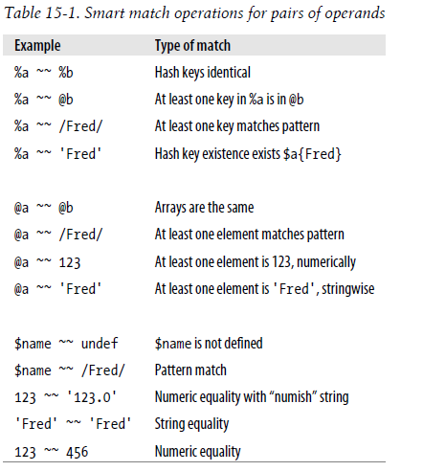
Smart Matching
Smart Match Precedence

Slide 55
given-when
given-when (like switch-case in C)
use 5.010; given( $ARGV[0] ) { when( /fred/i ) { say 'Name has fred in it‘; break } when( /^Fred/ ) { say 'Name starts with Fred' ; break;} default { say "I don't see a Fred" } }
If the when before the default has a continue, Perl goes on to the default too given( $ARGV[0] ) { when( $_ ~~ /fred/i ) { say 'Name has fred in it'; continue } when( $_ ~~ 'Fred' ) { say 'Name is Fred'; continue } # OOPS! when( 1 == 1 ) { say "I don't see a Fred" } # default }

Slide 56
given-when
Dump matching
use 5.010; given( $ARGV[0] ) { when( /^-?\d+\.\d+$/ ) {} #smart when( $_ > 10 ) {} #dumb }
given( $ARGV[0] ) { when( &name_has_fred( $_ ) ) { } #dumb
when with Many Items
foreach my $name ( @names ) { given( $name ) { ... } }
foreach my $name ( @names ) { when() {} when() {} … }

Slide 57
Process Management
The system Function (return 0 if success)
Create child process to execute the new program, perl wait
system "date";
system 'ls -l $HOME';
system "long_running_command with parameters &";
system 'for i in *; do echo == $i ==; cat $i; done';
my $tarfile = "something*wicked.tar"; my @dirs = qw(fred|flintstone <barney&rubble> betty ); system "tar", "cvf", $tarfile, @dirs;
system "tar cvf $tarfile @dirs"; # Oops!
!system "rm -rf files_to_delete" or die "something went wrong";

Slide 58
Process Management
exec functions (new program replace perl program)
exec "bedrock", "-o", "args1", @ARGV;
ENV variable
$ENV{'PATH'} = "/home/rootbeer/bin:$ENV{'PATH'}"; delete $ENV{'IFS'}; my $make_result = system "make";
Using Backquotes to Capture Output
my $now = `date`; # grab the output of date
my $output_with_errors = `frobnitz -enable 2>&1`;
my @who_lines = `who`;

Slide 59
Process Management
Processes as Filehandles
open DATE, "date|" or die "cannot pipe from date: $!"; my $now = <DATE>;
open MAIL, "|mail merlyn" or die "cannot pipe to mail: $!"; print MAIL "The time is now $now"; # presume $now ends in newline
open F, "find / -atime +90 -size +1000 -print|" or die "fork: $!"; while (<F>) { }
Fork (perlipc)
system "date"; => defined(my $pid = fork) or die "Cannot fork: $!"; unless ($pid) { # Child process is here exec "date"; die "cannot exec date: $!"; } waitpid($pid, 0); # Parent process is here

Slide 60
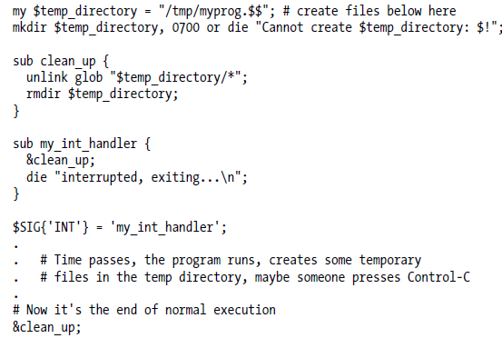
Process Management
Processes as Filehandles
open DATE, "date|" or die "cannot pipe from date: $!"; my $now = <DATE>;
Signal
kill 2, 4201 or die "Cannot signal 4201 with SIGINT: $!";

Slide 61
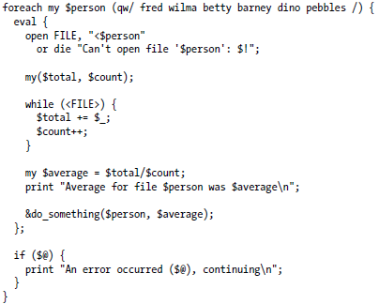
Advanced Perl Techniques
Trapping Errors with eval
eval is an expression, must end with ;
If eval doesn’t capture exception, it returns the the value of the last expression in the eval body, or the value with a return keyword
If eval captures exception, the return value is undef or an empty list. And the exception will be saved in $@ special variable
Don’t use exit in subroutine, use die when encounter problem

Slide 62
Advanced Perl Techniques
Picking Items from a List with grep
my @odd_numbers = grep { $_ % 2 } 1..1000;
my @matching_lines = grep { /\bfred\b/i } <FILE>;
my @matching_lines = grep /\bfred\b/i, <FILE>;
Transforming Items from a List with map
my @data = (4.75, 1.5, 2, 1234, 6.9456, 12345678.9, 29.95); my @formatted_data = map { &big_money($_) } @data;
print "The money numbers are:\n", map { sprintf("%25s\n", $_) } @formatted_data;
Unquoted Hash Keys
If the hash key is made up of nothing but letters, digits, and underscores without starting with a digit, you may be able to omit the quote marks $score{"fred"} => $score{fred}

Slide 63
Advanced Perl Techniques
Slices
my($name, $card_num, $addr, $home, $work, $count) = split /:/;
my(undef, undef, undef, undef, undef, undef, undef, undef, undef, $mtime) = stat $some_file;
my $mtime = (stat $some_file)[9];
my $card_num = (split /:/)[1];
my($card_num, $count) = (split /:/)[1, 5];
my($first, $last) = (sort @names)[0, −1];
my @numbers = ( @names )[ 9, 0, 2, 1, 0 ];
Array slice
my @numbers = @names[ 9, 0, 2, 1, 0 ];
print "Bedrock @names[ 9, 0, 2, 1, 0 ]\n"; # interpolated in a string
@items[2, 3] = ($new_address, $new_home_phone);

Slide 64
Advanced Perl Techniques
Hash slice
my @scores = ($score{"barney"}, $score{"fred"}, $score{"dino"});
my @scores = @score{ qw/ barney fred dino/ };
my @players = qw/ barney fred dino /; my @bowling_scores = (195, 205, 30); @score{ @players } = @bowling_scores; That last line does the same thing as if we had assigned to the three-element list ($score{"barney"}, $score{"fred"}, $score{"dino"})
print "Their scores were: @score{@players}\n";

